Slide 1
ILLINOIS STATEWIDE EFFORTS FOR PROVIDING JUSTICE INVOLVED INDIVIDUALS NEEDED SERVICES
Assistant Director Alyssa Williams
Chief of Programs Jennifer Parrack
Chief of Parole Jason Garnett

Slide 2
Direction – which way do we go?
Overview of IDOC Efforts
Goals
Progress

Slide 3
Looking at Corrections with a Different Lens

Slide 4
Incentive Based Population Management
As part of Illinois Department of Correction’s efforts at continual improvement, the Department is actively working to develop a more seamless and coherent system of incentives and opportunities.
This system will emphasize the reinforcement of positive behavior and rehabilitation over punishment and a reliance on holding offenses.
It will also emphasize the use of clear and attainable rewards for positive behavior as well as easily understood sanctions for misbehavior.
This revised system is built on six pillars : updates to security classification; implementation of statewide risk and needs assessment tool; individualized case planning; expansion and streamlining sentence credit; creation of re-entry pathways; and right sizing of community supervision.

Slide 5
Comprehensive Overhaul of Security Classification No More Time and Crime Classification
The Department has moved to establish and maintain a classification level system that creates a process for the classification of individuals primarily according to their behavior and commitment to rehabilitation while incarcerated rather than their crime of conviction and time on their sentence.
It is also IDOC’s aim to improve initial classification that occurs at intake to better match people to appropriate parent institutions based on needs, program identification, and other factors.
Every year, each incarcerated person will be reclassified. This will provide everyone the opportunity to reduce their security level, potentially allowing them to gain more privileges and greater access to programs at minimum security facilities, ATCs or re-entry centers.
Those individuals who participate in programs and generally avoid disciplinary infractions will now be able to drive their own reduction in security level.

Slide 6
Let’s get services targeted - Implementation of a Risk and Needs Assessment
IDOC has implemented a risk and needs assessment system.
Based on well-established evidence, these assessments help IDOC to better understand how to allocate resources to the incarcerated population.
This assessment system assists individuals in IDOC’s custody to understand the services that will most help them to avoid recidivating.
This tool also assigns people a risk to recidivate or “risk score.”
These scores help to indicate how likely someone is to be recommitted to IDOC based on rigorously researched evidence, allowing IDOC to focus specialized programming resources on those higher risk individuals and helping lower risk individuals work to reduce their sentence length.

Slide 7
Creation and Use of Individualized Case Planning
Another function of IDOC’s risk and needs assessment is to identify individual needs and to facilitate the development of a case plan that will help individuals in IDOC’s custody to quickly and effectively address those needs.
These individualized plans will identify gaps and deficiencies and plot a course on how to address them across five domains: criminal attitudes and behavioral patterns, employment, education, social supports, and family.
Moving forward, especially for individuals identified as high or moderate risk, the individualized case plan will become the guide for programming and effective rehabilitation.
People will be assigned to programs and prioritized based, in part, on their individualized case plans.

Slide 8
Progress – Where has this lead us?
Population management – reduction of the numbers
Enhanced program provision that is specifically geared towards the needs of the population
Integrity and fidelity of service provision
Development of new programs that are being evaluated for effectiveness. States are reaching out to Illinois now for guidance.
Creation of reentry pathways
Right sizing of the parole population through assessment and case management

Slide 9
Speaking of programs…..

Slide 10
What Makes Up the Program Department…
Chief of Programs and Support Services – Jennifer Parrack
Assistant to the Chief – Shalandra Burch
Office of Education and Vocational Services – Maria Miller
Behavioral Health Coordinator (Substance Abuse) – Vacant
Volunteer
Services – Scott Keen
Chaplaincy Services – Chase Wilhelm
Office of Sex Offender Services – Sarah Brown-Foiles
Correctional Industries – Kim Larson, CEO
Re-Entry Unit – Angie Mecagni, Acting Capacity

Slide 11
Program Updates
Mission changes to facilities
Expansion of work release
Implementation of risk assessment and enhancement to program services.
Enhancing Re-Entry Services
Increased collaborations with other Illinois State Agencies

Slide 12
Statewide Treatment Facilities
Sheridan Correctional Center – Substance Abuse Treatment Facility
Southwestern Correctional Center – Substance Abuse Treatment Facility
Joliet Treatment Center and Joliet Inpatient Treatment Center – Treatment for individuals in need of inpatient level of mental health care.

Slide 13
Facility Changes – Focus on Re-Entry
Lincoln Correctional Center – Rapid Re-Entry – 18 months and under to MSR.
Murphysboro Life Skills Re-Entry – Southern Region – 18 months to 5 years from MSR.
Jacksonville Correctional Center – Central Region – 18 months to 5 years from MSR.
Stateville Correctional Center – Northern Region
No set date for this full conversion
Kewanee Life Skills Re-Entry Center – Still application based – 3 to 7 years from MSR.

Slide 14
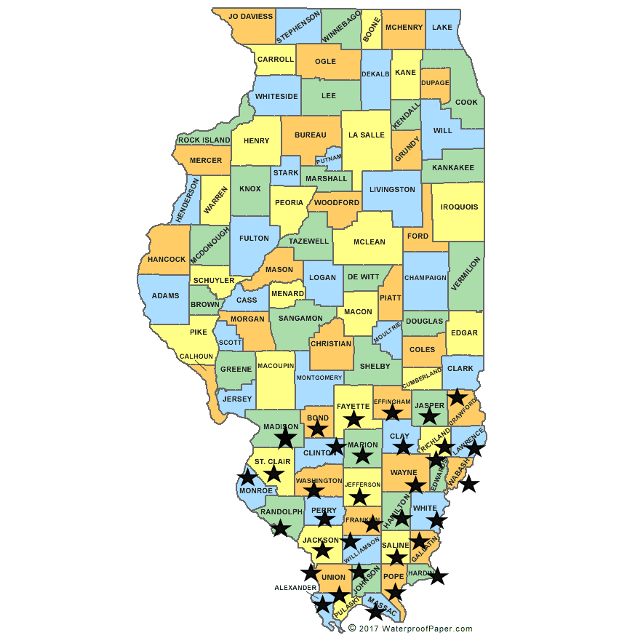

Slide 15
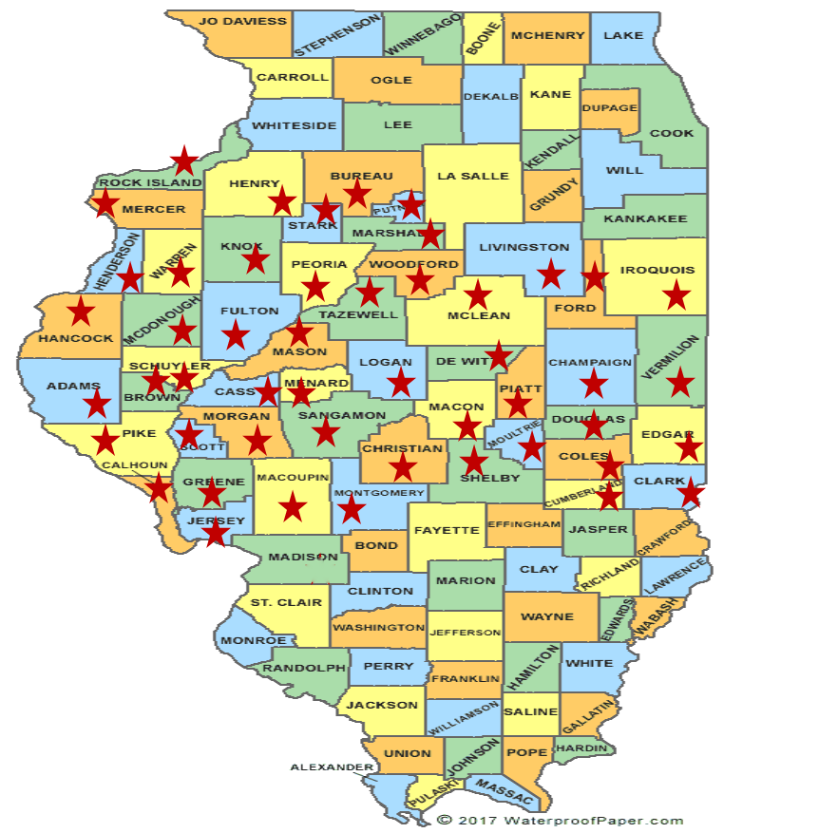

Slide 16
Work Release Centers
Expanded criteria for work release placement.
Attempting to expand timeframe from MSR for ATC placement.
Locations of ATCs
Fox Valley ATC – Aurora, Illinois – Women
Peoria ATC – Peoria, Illinois – Male
Safer Foundation - ATCs
North Lawndale ATC – Chicago – Male
Crossroads ATC – Chicago - Male

Slide 17
Prioritizing Programming
How do we know who needs what programming?
Assessments
Increasing staff training and ability to deliver clinical programming.
Increased clinical staffing numbers
Increased education staffing numbers
Supporting incentive-based wings/housing units/correctional facilities
Building blocks
Re-Entry facilities

Slide 18
ORAS Assessment
Case plans and clinical programming should be driven by the ORAS (Ohio Risk Assessment System) risk assessment.
PST: Prison Screening Tool – Intake Assessment
PIT: Prison Intake Tool - Completed if individual scores moderate or high on the PST – Complete Case Plan on moderate, high or very high
SRT: Supplemental Re-entry Tool – Complete if individual has been in IDOC for over 60 days with no PST/PIT - incarcerated for less than 4 years
Complete case plan on moderate, high or very high
RT: Re-entry Tool - incarcerated for more than 4 years
Complete case plan on moderate, high or very high
CST: Community Supervision Tool

Slide 19
ORAS Risk Assessment
Risk Level
Low Risk – Low risk of recidivism, requiring minimal programming or intervention.
Overrides
Overrides may be approved one level higher or one level lower per assessment
Case Plans
Be completed on all individuals that score moderate or higher on any assessment tool (there will be updates to the MSR timeline on this objective)
Moderate Risk – Moderate risk for an individual to recidivate.
High Risk – High risk for an individual to recidivate.
Very High Risk – Very high risk for an individual to recidivate.
Overrides shall not occur more than 10% of the time. Override rates may increase up to 30% if a CAS or SWII has a specialized caseload.
Reasons for an override shall be documented in the online system, after the assessment is entered.
Be developed by the CAS or SWII in conjunction with the individual.

Slide 20
Case Plans
Case plan should address elevated domains through clinical programming, treatment and education.
ORAS Domains: criminal attitudes and behavioral patterns, employment, education, social supports, and family.
Clinical Programming:
Thinking for a Change
Start Now
Anger Management (JAWS)
Aim Higher
Inside out Dads
Substance Abuse Education/Treatment

Slide 21
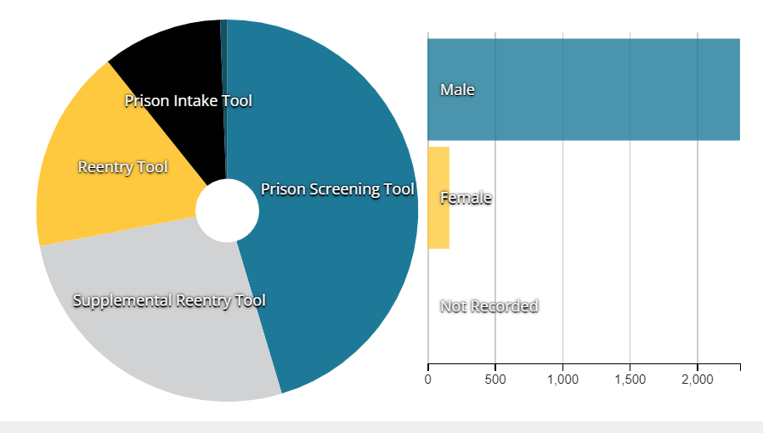
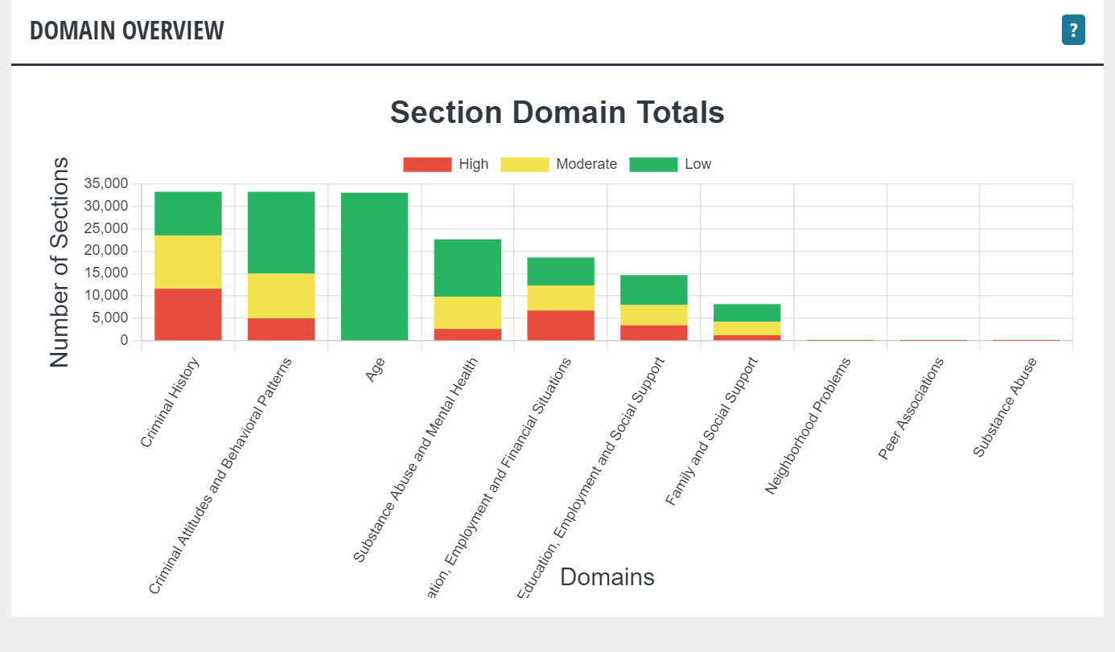

Slide 22
IDOC Educational Services
ABE – Adult Basic Education
ADV/ABE - Advance Basic Education
GED Programming – Labs at each IDOC facility
Community Colleges - Lake Land, Danville Area College, Kaskaskia
Vocational services and associate level academic courses
Bachelor and Master Level Educational Programs - Expansion of post secondary education with Pell restoration

Slide 23
IDOC Educational Services 7/1/22 to 11/30/22

Slide 24
Community Colleges
Academic Level College Courses – Lake Land, Danville, Kaskaskia.
Vocational Classes - College Credit Courses
Automotive Technology/Autobody
Culinary Arts
Welding
Manufacturing
Warehousing
Construction
Horticulture
Career Tech
Custodial Maintenance
Mechatronics

Slide 25
Bachelor and Master Level Educational Options
Adler University – Bachelor’s in Psychology – Big Muddy CC
Augustana - Bachelor’s in Liberal Arts with a Communications Major – East Moline CC
Lewis University - Bachelor’s degree program in Professional Studies – Sheridan CC
Danville Correctional Center:
Associate in Arts & Associate in General Studies for Danville Area Community College
Divine Hope Bible College - Associate Certificate (not Degree) & Bachelor Certificate (not Degree)
University of Illinois / Equal Justice Project - Educational Studies Certificates/ Humanity Certificates
Eastern Illinois University - Bachelor’s degree in General Studies – Graduation of 3 students on 1/12/23.

Slide 26
Bachelor and Master Level Educational Options
Logan Correctional Center:
Northwestern Prison Education Program – Associates degree in Liberal Arts
North Park Theological Seminary -- Master of Arts in Restorative Arts
Stateville Correctional Center:
North Park: Bachelors / Masters (Restorative Arts & Christian Ministry)
Northwestern - A.A through Oakton Community College / Bachelor - (Liberal Arts curriculum for both degrees)
Northeastern (UWW – University Without Walls) - Bachelors (Liberal Arts)
DePaul University – Inside out Program – Non-credit bearing

Slide 27
Vocational Programming
Evaluate current vocational programming
Align current vocational programs with industry trends
Begin to incorporate industry recognized credential into existing identified vocational
Better align to Correctional Industries for work based learning

Slide 28
Illinois Correctional Industries
The mission of Illinois Correctional Industries (ICI) is to provide incarcerated individuals with vocational skills and training necessary to be successful upon release from prison.
ICI currently has programs operating in 16 Illinois Department of Corrections facilities producing a variety of products and providing various services.
ICI focuses on providing skills needed to assist incarcerated individuals in successful rehabilitation and reentry into the community. More than 950 men and women are employed in meaningful work situations that aid in developing useable skills and positive work habits.
Working to add Department of Labor Apprenticeships to ICI shops.

Slide 29
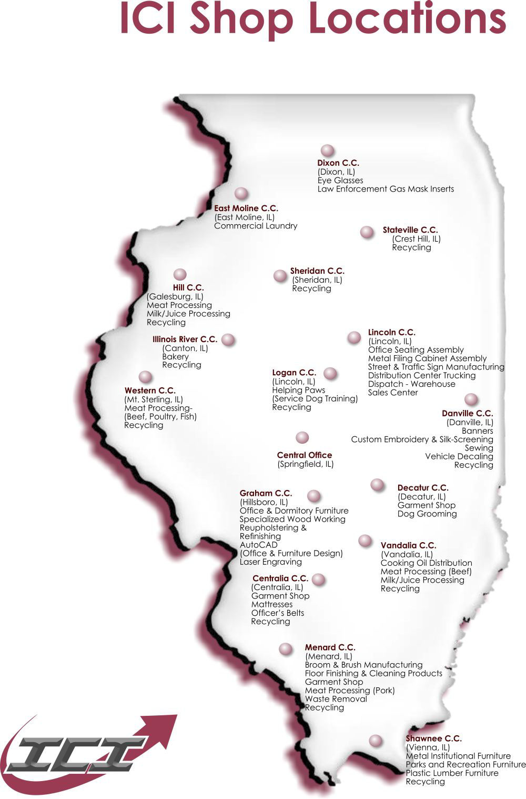

Slide 30
Earned Program Sentence Credit
Behavior Modification : designed to provide individuals with the means to identify and alter undesired thinking and behavioral patterns.
Life Skills: designed to promote personal skills to better prepare the individual for a productive return to society.
Community Re-Entry: designed to provide individuals with information on release procedures and the tools to assist them in a positive re-entry into society.
Education & Vocational: authorized academic and vocational programs.
Substance Abuse Education or Treatment: substance use education, counseling, or treatment for drug and/or alcohol abuse.
Correctional Industries: Work based learning

Slide 31
Office of Sex Offender Services
Voluntary Sex Offender Treatment Program
The VSOTP is offered to individuals in custody who present as moderate to high risk of sexual recidivism.
Assessments utilized by IDOC sex offender services in the Static 99R and Stable 2007.
The VSOTP is provided by licensed sex offender treatment providers and follow Sex Offender Management Board guidelines.
Big Muddy River Correctional Center – 50 active participants (200 treatment beds when fully staffed)
Taylorville Correctional Center - 100 active participants (250 treatment beds when fully staffed)
Length of treatment depends on the individual but is typically between 12 and 18 months
Roughly 150 people past their MSR date

Slide 32
Addiction Recovery Management Services
Baseline services provided throughout the agency are:
Drug Education – All sites are providing the Hazelden Curricula for drug education. This is a voluntary 12 week group for baseline drug information.
Substance Abuse Screenings – All sites are able to provide the standardized Texas Christian University Screening Tool to identify individuals who need substance abuse treatment. In addition, all individuals coming into the Department of Corrections are being screened with this tool by TASC and/or other vendor/staff. There is a statewide substance abuse wait list that is generated through the Reception and Classification Units as a result of the front-end identification of individuals who need substance abuse treatment.
Support Groups – Alcoholics Anonymous and Narcotics Anonymous. 12 step/support programming is available at all sites.

Slide 33
Substance Abuse Treatment Partners
TASC:
Completes intake substance use screenings at IDOC reception centers: NRC (Stateville), Graham, Menard and Logan.
Provides treatment at SWICC with pre-release and post release services.
Mom and Babies program at Decatur CC.
Provides pre-release and post release services at Sheridan.
Comprehensive Connections: Big Muddy Correctional Center
Geo:
Jacksonville Correctional Center
Day Reporting Centers: East St. Louis, Decatur, Rockford and Chicago (multiple locations across the city)

Slide 34
Substance Abuse Treatment Partners
Westcare: All programs are SUPR Licensed.
Sheridan CC: Substance Use Disorder TX/Therapeutic Community
Total beds: 1250; Current: 708; orientation: 166
Lincoln CC: Substance Use Disorder TX
Total beds: 50; Current: 48; orientation: 0; Waitlist: 72
DuQoin IIP: Substance Use Treatment
Program model has recently changed from 4 months to 1 year.
48 people currently in the program; 12 in orientation.
Logan CC: Gender Specific Substance Use Disorder TX
Total beds: 130; Current: 96; Waitlist: 38
Logan CC: Dual Diagnosis TX
Total beds: 52; Current 52; waitlist: 56
Decatur CC: Dual Diagnosis TX
Total beds: 26; current: 26; waitlist: 74

Slide 35
Re-Entry Unit in IDOC
Created in the Fall of 2019
Roughly 1,200 to 1,600 individuals are released from IDOC each month.
Goals of the Re-Entry Unit:
Improve Re-Entry Services and collaboration with other state agencies and community-based organizations.
Bridge the gap between correctional facilities and parole division.
Bring structure to release processes and transitional housing services.
Ensure compliance with new and updated changes in the Unified Code of Corrections around pre and post release services for individuals leaving IDOC custody.

Slide 36
Re-Entry Specialist
730 ILCS 5/3-18-30: Reentry Specialist
House Bill 3465 - Reentry Specialist was signed into law on May 13, 2022 and is now Public Act 102-0760. This law establishes the duties and responsibilities of Reentry Specialists. Effective January 1, 2023.
Unified Code of Corrections: Sec. 3-18-30. Reentry Specialist. Irrespective of whether an institution or facility has access to a reentry program under this Article, each institution or facility shall hire a reentry specialist to assist with the reentry of offenders into the community who have been committed to the Department for commission of a felony. The Department shall provide by rule for the duties and responsibilities of reentry specialists, including, but not limited to, signing inmates up for health care under the federal Patient Protection and Affordable Care Act.
Correctional Counselor III – Reentry Counselor

Slide 37
Re-Entry Counselors
Job Responsibilities:
State and Federal agency liaison: Veteran Affairs, DCFS, DHS, SOS, IDES and Social Security Administration
Manages the Re-Entry Resource Rooms
Computers, Resource guides, Webex In-reach series
Medicaid enrollment and SNAP enrollment (expansion to all IDOC facilities will be completed in 2023)
Vital document obtainment and State of Illinois identification card
Re-Entry Prep Program (formerly known as parole school)
Re-Entry Summits (2x a year)

Slide 38
Collaboration With Other State Agencies
IDPH –Processing of birth certificate requests; Partner in running Summits of Hope; HIV education in IDOC correctional facilities.
Secretary of State – Processing of state IDs
HFS – Medicaid enrollment and working on the PAS screen process for high mental health and medical need individuals.
DHS – Supplemental Nutrition Assistance Program enrollment
IDHA – Housing pilot for 75 individuals returning to Cook, Boone, Lake, Stephenson, Winnebago, and Champaign counties.

Slide 39
Healthcare Enrollment
Individuals released after January 1st, 2021, are being screened for Medicaid eligibility in accordance with 730 ILCS 5/3-14-1(a-3).
Process is initiated 60 days from individual's release.
Staff assist with application completion.
For those approved, Individuals leave the facility with a medical card.
There is at least one staff member at each facility, and a Corrections Assessment Specialist at the parole offices, who have access to the Integrated Eligibility System.
Important to ensure individuals have access to health care services.

Slide 40
Supplemental Nutrition Assistance Program (SNAP)
Coordination between local DHS offices and correctional staff.
12 correctional centers are currently participating.
Logan, Decatur, Il. River, Lincoln, Vienna, Kewanee Life Skills Re-Entry Center, Graham, Centralia, Murphysboro Life Skills Re-Entry Center, Jacksonville, Lawrence and Western.
All IDOC facilities will have this option by the end of 2023.
Applications completed 2 weeks from release.
Leaves the correctional center with their LINK card and funds are activated within 72 hours.

Slide 41
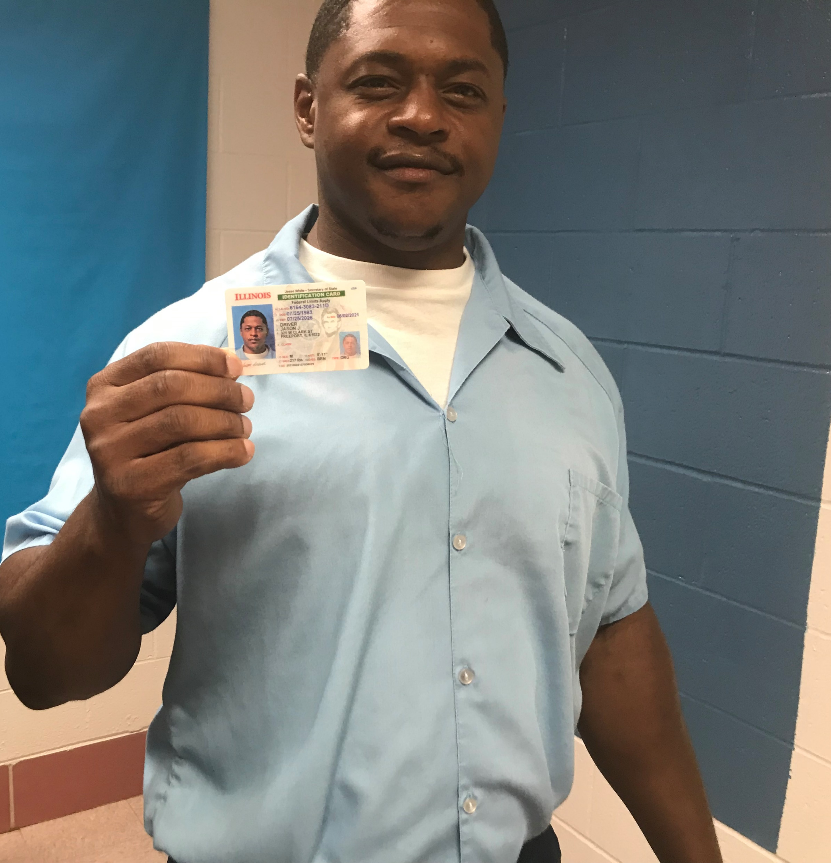
Secretary of State – State ID Program
1,345 State IDs have been issued since the program started.
State IDs are being issued at every IDOC facility.
Limitations:
Individuals do not have their vital documents – variety of reasons
Interstate compact – need to have a state of Illinois approved address
Timeframe restriction on social security card and backlog in processing social security cards.

Slide 42
Introduction to Technology
Computers
WebEx TVS
Educational classes
Connections to community-based organizations prior to release
WebEx In-Reach Series
Allowed for organizations to reach multiple people across multiple facilities at one time.
Interactive dialogue
Monthly schedules

Slide 43
Re-Entry Resource Rooms
Computers with approved internet sites
Ability to complete Medicaid application on-line
Credit score information
Legal aid information
Workforce information
Il. Dept. of Employment Services
Directory of elected state, county and
municipal officials

Slide 44
Workforce Development
Enhance
Enhance workforce development and partnerships with businesses around the state to improve employment options and placement.
Cultivate
Cultivate and enhance relationships. Continue to meet with the local workforce areas and IDES regional personnel where IDOC prisons are located and develop a process for their staff to work with offenders around employment.
Increase
Increase vocational training with WOIA funds where available in labor demand fields.
Develop
Develop regional job fairs and then facility specific job fairs in specific employment fields. The goal of each job fair is to place at least 10% (to start) of the offenders that participated in a job prior to release.
Assemble
Assemble informational packets together about IDOC vocational training programs and ICI training and employment. Continue to work with DCEO for support with grant funds and statewide initiatives.

Slide 45
Specialized Housing
IDOC has seen a reduction in gate violations
Increased diversion options
Discharges – linkage to hospitals
Coordination with DHS – Civil Commitment
Flexible Housing Pool – Bridge Housing
Increase in nursing home options
PRG: Has increased recovery home options through collaboration with SUPR.

Slide 46
PAROLE OVERVIEW
Parole consists of 5 Districts Statewide.
Parole has four specialized units (Sex Offender Unit, Gender Specific Unit, Interstate Compact, and a Special Security Unit).
Parole has approximately 400 employees with 350 of them being Supervisors and Agents.

Slide 47
IDOC – PAROLE DIVISION MISSION STATEMENT
Our mission is to promote public safety through offender supervision utilizing re-entry resources, community partnership, and graduated sanctions. It is our goal to reduce recidivism and assist offenders in becoming crime-free, and responsible members of society.

Slide 48
Right-sizing of Community Supervision
Most individuals leaving IDOC facilities are required to serve a mandatory supervised release term.
IDOC has made changes to how it administers MSR terms by adopting a risk assessment tool instead of relying holding offenses.
As a result, individuals who are deemed a low or moderate risk to recidivate will be placed on lower levels of supervision and, assuming they are complete the orders set by the Prisoner Review Board (PRB) and comply with their MSR conditions, may be able to earn an early discharge from MSR.

Slide 49
RISK ASSESSMENT TOOL
CREATION OF RISK ASSESSMENT TOOL IS A RESULT OF THE 2009 ILLINOIS CRIME REDUCTION ACT
EVIDENCE BASED
RISK ASSESSMENT RESULTS SHALL AIDE IN THE DECISION-MAKING PROCESS FOR SUPERVISION LEVELS AND EARLY DISCHARGE RECOMMENDATIONS
MEASURES THE RISK TO RECIDIVATE

Slide 50
RISK ASSESSMENT
Initial Risk Assessment is conducted at the Initial Face-to-Face Visit
Re-Assessments shall be completed every 3 months at minimum.
The Risk Assessment is used to assist in Level Reductions.

Slide 51
CASE MANAGEMENT
Face-to-Face Contacts
Level 1: One FTF contact every 30 days at a minimum
Level 2: One FTF contact every 60 days at a minimum; and One Video Contact in between the 60 day FTF.
Level 3: One FTF contact every 90 days at a minimum and One Video Contact within the 60 remaining days.

Slide 52
CASE MANAGEMENT
Sanction Matrix/Reward Matrix
Parole Agents shall utilize the Sanction matrix and review alternatives to re-incarceration by discussing the parolee’s situation with the Parole Supervisor.
Parole Agents shall utilize the Rewards matrix for better case management and to advise the parolee of their positive behaviors.

Slide 53
BI SmartLINK
Allows the Parole Agent to:
Conduct Video Visits with Parolees
Communicate with Parolee via text messages
Allows Parolee to scan certificates of completion, ID documentation, registry info, etc.

Slide 54
RRD’s
The RRD program requires agents to review parolees monthly for RRD eligibility and identify all cases for submission for supervisory review.
The RRD process is based on case management and evidence-based practices instead of their mittimus.

Slide 55
DAY REPORTING CENTERS
There are six DRC’S that serve as resource centers and reentry hubs for persons under parole supervision in high-impact regions throughout the state, who are vulnerable to drugs, crime, gangs, violence, unemployment, poverty and family dissolution.
The centers provide highly structured programs and counseling that offers an alternative sanction for nonviolent parole violators. The centers also provide services for parolees to complete their Parole Board Orders.

Slide 58
Questions

